Slide 2
What's SOLID?
Single Responsibility Principle (SRP)
S
Open / Closed Principle (OCP)
O
Liskov Substitution Principle (LSP)
L
Interface Segregation Principle (ISP)
I
D
Dependency Inversion Principle (DIP)

Slide 3
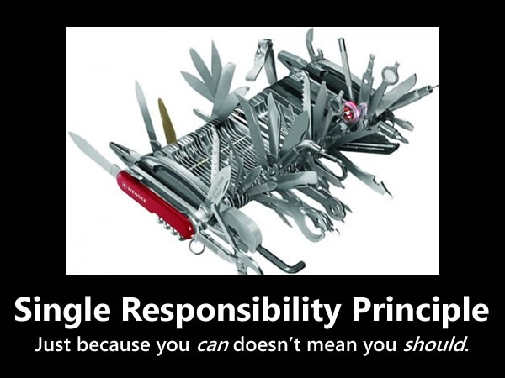
Single Responsibility Principle
“The Single Responsibility Principle (SRP) states that a class should have only one reason to change. ” — Agile Software Development, Principles, Patterns, and Practices．
Implementation:
Advantages:
Logging
Error Handling
HTTP Client
……
Low complexity
High maintainability
High readability
……

Slide 4
Single Responsibility Principle
Example:
interface Connection { void connect(String host); void disconnect(); } interface DataTransfer{ void send(byte[] data); String receive(); } interface IClient extends DataTransfer, Connection{ String getServiceName(); String getIPAddress(); }
interface IClient{ String getServiceName(); String getIPAddress(); void connect(String host); void disconnect(); void send(byte[] data); String receive(); }
Decompose

Slide 5
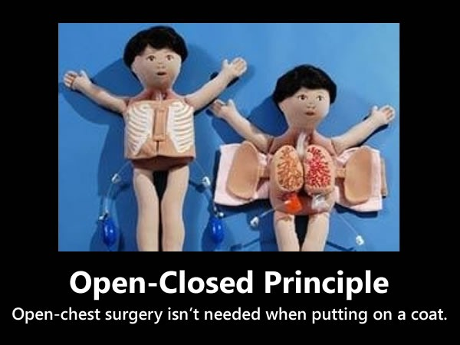
Open / Closed Principle
“The Open-Closed Principle (OCP) states that software entities (classes, modules, methods, etc.) should be open for extension, but closed for modification.”
Related design pattern:
Template Pattern
Factory Pattern
Decorator Pattern
……
Notes:
Eureka-client:EurekaHttpClientDecorator

Slide 6
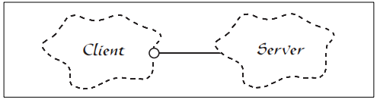
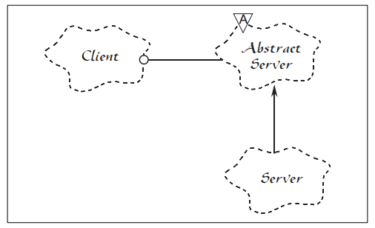
Open / Closed Principle
Example:
public class Client{ private EurekaServer server; public void connect(EurekaServer server) { } }
Implement
public class ClientSRP{ private AbstractServer server; public void connect(AbstractServer server) { } } abstract class AbstractServer implements IServer{ } class EurekaServer extends AbstractServer{ } class ZookeeperServer extends AbstractServer{ }
Implement
Notes:
Eureka-client:EurekaHttpClientDecorator

Slide 7
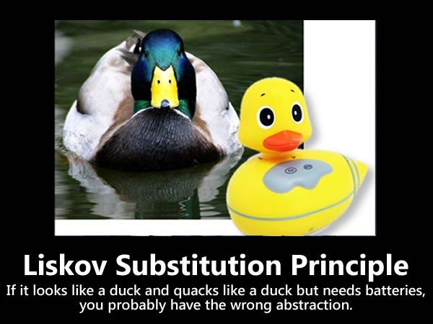
Liskov Substitution Principle
“The Liskov Substitution Principle (LSP) states that subtypes must be substitutable for their base types.”
Notes:
Eureka-client:EurekaHttpClientDecorator

Slide 8
Liskov Substitution Principle
interface IServer { boolean isAvailable(); } abstract class AbstractServer implements IServer{ private boolean available; abstract void replicate(); @Override public boolean isAvailable() { return this.available; } } class EurekaServer extends AbstractServer{ void replicate(){ System.out.print("Eureka Server"); } } class ZookeeperServer extends AbstractServer{ void replicate(){ System.out.print("Zookeeper Server"); } @Override public boolean isAvailable() { return false; } }
Example:
Subclasses must implement abstract methods of the parent class, but must not override the non-abstract methods of the parent class.
public class Client { private AbstractServer server; public void connect(AbstractServer server) { //.... if(server.isAvailable()){ server.replicate(); } } }
Notes:
Eureka-client:EurekaHttpClientDecorator

Slide 9
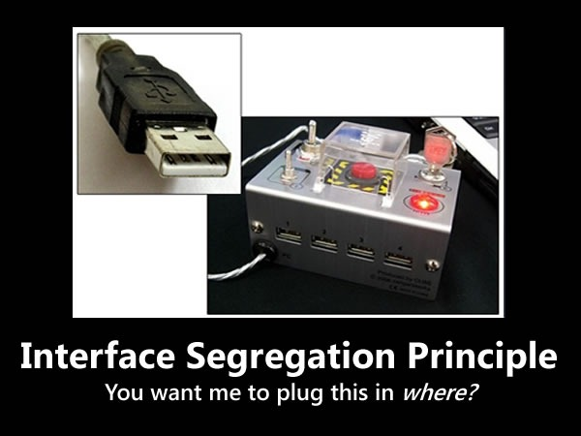
Interface Segregation Principle
“The Interface Segregation Principle (ISP) states that clients should not be forced to depend on methods that they do not use.”
Notes:
Eureka-client:EurekaHttpClientDecorator

Slide 10
Interface Segregation Principle
Example:
public interface Bird { void fly(); void incubateEggs(); void eat(); } class Penguin implements Bird{ @Override public void fly() { System.out.print("I cannot fly..."); } @Override public void incubateEggs() { System.out.print("I can incubate eggs..."); } @Override public void eat() { System.out.print("I can eat..."); } }
Notes:
Eureka-client:EurekaHttpClientDecorator

Slide 11
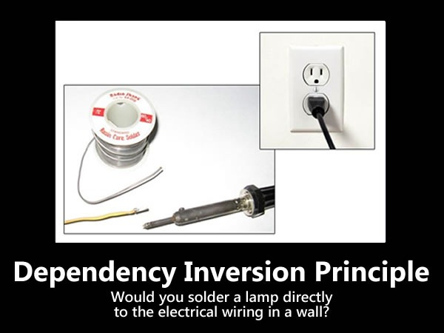
Dependency Inversion Principle
“The Dependency Inversion Principle (DIP) states that high level modules should not depend on low level modules; both should depend on abstractions. Abstractions should not depend on details. Details should depend upon abstractions.”
Related design pattern:
Template Pattern
……
Notes:
Eureka-client:EurekaHttpClientDecorator

Slide 12

Thanks！

